Slide 1
Argument Identification
Identifying Texts Containing Reasoning
by
Jeremy Sakovich

Slide 2
Introduction: Reasoning Systems
One of the most distinctive features of human intelligence is the ability to reason through the use of logical arguments.

Slide 3
Introduction: Reasoning Systems
A highly robust Artificial Intelligence system would be able to:
1) Identify human reasoning in text

Slide 4
Introduction: Reasoning Systems
A highly robust Artificial Intelligence system would be able to:
1) Identify human reasoning in text
2) Parse out components of the structure of the reasoning present in the text

Slide 5
Introduction: Reasoning Systems
A highly robust Artificial Intelligence system would be able to:
1) Identify human reasoning in text
2) Parse out components of the structure of the reasoning present in the text
3) Engage with reasoning in texts by offering:
Counter points
Counter arguments
Fact checking

Slide 6
IBM’s Solution: Project Debater
IBM’s Project Debater team is engaged in research to develop an Artificial Intelligence system capable of carrying a variety of reasoning tasks.

Slide 7
IBM’s Solution: Project Debater
IBM’s Project Debater team is engaged in research to develop an Artificial Intelligence system capable of carrying a variety of reasoning tasks.
Project Debater aims to create a reasoning system which can debate meaningfully with highly skilled human debaters.

Slide 8
IBM’s Solution: Project Debater
IBM’s Project Debater team is engaged in research to develop an Artificial Intelligence system capable of carrying a variety of reasoning tasks.
Project Debater aims to create a reasoning system which can debate meaningfully with highly skilled human debaters.
It is thought such technology holds a number of useful applications in a variety of fields.

Slide 9
The Problem: Manual Tagging of Texts
One of the most costly tasks in the kind of research needed to make Project Debater a success is the time it takes to manually tag texts appropriate for use in training machine learning models.

Slide 10
The Problem: Manual Tagging of Texts
One of the most costly tasks in the kind of research needed to make Project Debater a success is the time it takes to manually tag texts appropriate for use in training machine learning models.
It can take countless hours of human work in reading simply to identify texts which contain arguments.

Slide 11
My Solution:
Create a machine learning model capable of automating the costly step of identifying arguments.

Slide 12
My Approach:
Create a corpus (a set of texts) tagged manually as arguments or non-arguments.

Slide 13
My Approach:
Create a corpus (a set of texts) tagged manually as arguments or non-arguments.
Train a model on a subset of the corpus.

Slide 14
My Approach:
Create a corpus (a set of texts) tagged manually as arguments or non-arguments.
Train the model on a subset of data.
Test the model on the remaining data.

Slide 15
Results:
When tested, the trained model successfully identified 78% of the argument texts.

Slide 16
Limitations:
There are some limitations to the model:

Slide 17
Limitations:
The primary limitation to the model:
A large portion of the training data was from United Nations transcripts.

Slide 18
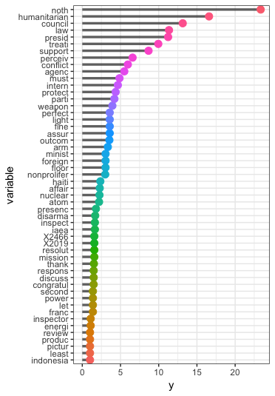
Importance of the stem words used in the trained model

Slide 19
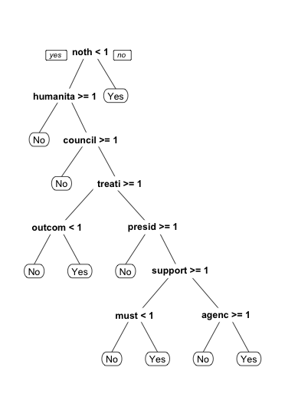
Decision Tree

Slide 20
Recommendations:
Retrain a model with a more varied dataset.

Slide 21
Recommendations:
Retrain a model with a more varied dataset.

Slide 22
Recommendations:
Retrain a model with a more varied dataset.
Try an approach which would involve creating a dictionary of common argument “indicator” words: because, therefore, consequently...

Slide 23
Conclusion:
Overall, this preliminary study shows that it is possible to train a model capable of identifying texts which contain arguments.

Slide 24
Conclusion:
Overall, this preliminary study shows that it is possible to train a model capable of identifying texts which contain arguments.
With further iteration and work, it could be a significant cost saver in terms of time to utilize such a model to aide IBM’s Project Debater team.

